Slide 1
LECT 1: Software and Software Engineering
Course Supervisor: Syeda Nazia Ashraf
Software Engineering: A Practitioner’s Approach, 7/e
by Roger S. Pressman

Slide 2
Instructor: Syeda Nazia Ashraf
Lecturer, CS Department, SMIU, Karachi and have 9 years of experience.
PhD(CS) scholar in Bahria University Karachi
M.Engg. in Computer Systems from NED University, Karachi
BS Computer Engg. from SSUET, Karachi
More than 2 years of Experience in FUUAST, Karachi

Slide 3
Course Outline
Introduction to Software and Software Engineering
SDLC and SWOT Analysis
Process Models
Agile Development
Principles that Guide Practice
Understanding Requirements: Requirement Engineering
Understanding Requirements: SRS Document
UML Diagrams
Requirements Modeling: Scenarios, Information, and Analysis Classes
Requirements Modeling: Flow, Behavior, Patterns, and WebApps

Slide 4
Course Outline (Cont.)
Managing Software Projects: Project Management Concepts, Risk Management, Maintenance and Reengineering
Software Quality Management: Software Quality Assurance, Software Testing Strategies
Software Quality Management: Product Metrics
Design Concepts
Architectural Designs

Slide 5
Grading
Quizzes = 10%
Assignments = 10%
Report / Presentation= 15%
Class Participation = (Attendance, Punctuality, Active participation in Class)= 5%
Midterm = 20%
Final Exam = 40%
Course Web Page:
http:// lms.smiu.edu.pk
Email : snazia@smiu.edu.pk

Slide 6
Text Book:
Software Engineering: A Practitioner's Approach Roger S. Pressman 8th Edition
Reference Books:
Software Engineering 8E by Ian Sommerville, Addison Wesley; 8th Edition (2006). ISBN-10: 0321313798 2.
Systems Analysis and Design by Gary B. Shelly, Thomas J. Cashman and Harry J. Rosenblatt, Course Technology; 7th Edition (2007). ISBN-10: 1423912225

Slide 7
Course Objectives
1. Knowledge of basic SW engineering methods and practices, and their appropriate application.
2. Describe software engineering layered technology and Process frame work.
3. A general understanding of software process models such as the waterfall and evolutionary models.
4. Understanding of software requirements and the SRS documents.
5. Understanding of the role of project management including planning, scheduling, risk management, etc.
Describe data models, object models, context models and behavioural models.
Understanding of different software architectural styles.
Understanding of implementation issues such as modularity and coding standards.
Understanding of approaches to verification and validation including static analysis, and reviews.
Understanding of software testing approaches such as unit testing and integration testing.
11. Describe software measurement and software risks.
12. Understanding of software evolution and related issues such as version management.
13. Understanding on quality control and how to ensure good quality software.

Slide 8
Learning Outcomes
1. Basic knowledge and understanding of the analysis and design of complex systems.
2. Ability to apply software engineering principles and techniques. 3. Ability to develop, maintain and evaluate large-scale software systems. 4. To produce efficient, reliable, robust and cost-effective software solutions. 5. Ability to perform independent research and analysis. 6. To communicate and coordinate competently by listening, speaking, reading and writing English for technical and general purposes. 7. Ability to work as an effective member or leader of software engineering teams.
8. To manage time, processes and resources effectively by prioritising competing demands to achieve personal and team goals Identify and analyzes the common threats in each domain.
9. Ability to understand and meet ethical standards and legal responsibilities.

Slide 9
On completion of this Subject / Course the student shall be able to:
S.No. | Objectives | Outcomes
1. | Understand basic SW engineering methods and practices, and their appropriate application. | 1
2. | Understand understanding of software process models such as the waterfall and evolutionary models. | 3
3. | Role of project management including planning, scheduling and, risk management. | 5
4. | Discuss data models, object models, context models and behavioural models. | 6
5. | Understand of different software architectural styles and Process frame work. | 2,7
6. | Understand of implementation issues such as modularity and coding standards. | 8
7. | Understand to verification and validation including static analysis, and reviews. | 9,10
8. | Describe software measurement and software risks. | 11
9. | Discuss software evolution and related issues such as version management. | 12
10. | Understand on quality control and how to ensure good quality software. | 13
Note: For each of the OBJECTIVE indicate the appropriate OUTCOMES to be achieved.

Slide 10
What is Software?
Software is: (1) instructions (computer programs) that when executed provide desired features, function, and performance; (2) data structures that enable the programs to adequately manipulate information and (3) documentation that describes the operation and use of the programs.

Slide 11
Why Software is Important?
The economies of ALL developed nations are dependent on software.
More and more systems are software controlled ( transportation, medical, telecommunications, military, industrial, entertainment)
Software engineering is concerned with theories, methods and tools for professional software development.
Expenditure on software represents a significant fraction of GNP (Gross National Product) in all developed countries.

Slide 12
Software
What is it? Computer software is the product that software engineers design and build. It encompasses programs that execute within a computer of any size and architecture, documents that encompass hard copy and virtual forms, and data that combine numbers and text but also includes representation of pictorial, video, and audio information.
Who does it? Software Engineers build it, and virtually everyone in the industrialized world uses it either directly or indirectly.
Why is it important? Because it effects nearly every aspect of our lives and has become pervasive in our commerce, our culture, and our everyday activities.
What are the steps? You build computer software like you build any successful product, by applying an agile, adaptable process that leads to a high-quality result that meets the needs of the people who will use the product. You apply a software engineering approach.
What is the work product? From the point of view of a software engineer, the work product is the programs, documents and data. But from the user’s viewpoint, the work product is the resultant information that somehow makes the user’s world better.

Slide 13
Software Characteristics
1. Software Development:
“Software is developed or engineered; it is not manufactured in the classical sense”. (Because it does not have physical existence).
Although some similarities exist between software development and hardware manufacture, the two activities are fundamentally different. In both activities, high quality is achieved through good design, but the manufacturing phase for hardware can introduce quality problems that are nonexistent (or easily corrected) for software.
Both activities are dependent on people, but the relationship between people applied and work accomplished is entirely different. Both activities require the construction of a "product" but the approaches are different.
Software costs are concentrated in engineering. This means that software projects cannot be managed as if they were manufacturing projects.

Slide 14
Software Characteristics
2. Software doesn't "wear out.“: but it deteriorates (due to change).
Hardware has “bathtub curve” of failure rate in Figure 1.1 ( high failure rate in the beginning, then drop to steady state, then cumulative effects of dust, vibration, abuse, temperature extremes, and many other environmental maladies occurs). Stated simply, the hardware begins to wear out.
Software is not susceptible to the environmental maladies that cause hardware to wear out. In theory, therefore, the failure rate curve for software should take the form of the “idealized curve” shown in Figure 1.2. Undiscovered defects will cause high failure rates early in the life of a program. However, these are corrected (ideally, without introducing other errors) and the curve flattens as shown

Slide 16
Wear vs. Deterioration

Slide 17
Software Characteristics
Another aspect of wear illustrates the difference between hardware and software. When a hardware component wears out, it is replaced by a spare part. There are no software spare parts. Every software failure indicates an error in design or in the process through which design was translated into machine executable code. Therefore, software maintenance involves considerably more complexity than hardware maintenance.

Slide 18
Software Characteristics
3. Although the industry is moving toward component-based assembly, most software continues to be custom built:
In the hardware world, component reuse is a natural part of the engineering process. In the software world, it is something that has only begun to be achieved on a broad scale. A software component should be designed and implemented so that it can be reused in many different programs.

Slide 19
Software Applications
1. System software: such as compilers, editors, file management utilities
2. Application software: stand-alone programs for specific needs.
3. Engineering/scientific software: Characterized by “number crunching” algorithms. Such as automotive stress analysis, molecular biology, orbital dynamics etc.
4. Embedded software: resides within a product or system. (key pad control of a microwave oven, digital function of dashboard display in a car)
5. Product-line software: focus on a limited marketplace to address mass consumer market. (word processing, graphics, database management)
6. WebApps (Web applications): network centric software. As web 2.0 emerges, more sophisticated computing environments is supported integrated with remote database and business applications.
7. AI software: uses non-numerical algorithm to solve complex problem. Robotics, expert system, pattern recognition game playing

Slide 20
SW APPLICATIONS- NEW CATEGORIES
New challenges have appeared on the horizon:
Open world computing—pervasive, ubiquitous, distributed computing due to wireless networking. How to allow mobile devices, personal computer, enterprise system to communicate across vast network.
Netsourcing—the Web as a computing engine. How to architect simple and sophisticated applications to target end-users worldwide.
Open source—”free” source code open to the computing community (a blessing, but also a potential curse!)
Also … (see Chapter 31)
Data mining
Grid computing
Cognitive machines
Software for nanotechnologies

Slide 21
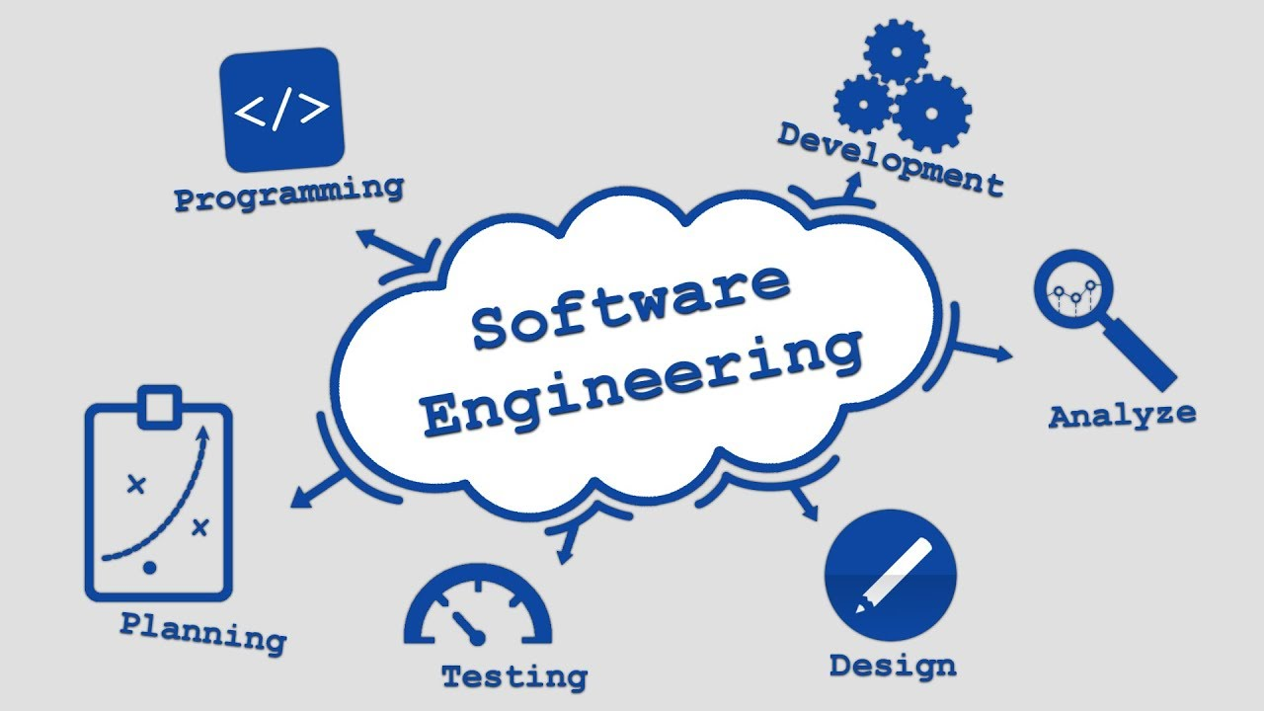
Software Engineering Definition
The seminal definition:
[Software engineering is] the establishment and use of sound engineering principles in order to obtain economically software that is reliable and works efficiently on real machines.
The IEEE (Institute of Electrical and Electronic Engineers) definition:
Software Engineering: (1) The application of a systematic, disciplined, quantifiable approach to the development, operation, and maintenance of software; that is, the application of engineering to software. (2) The study of approaches as in (1).

Slide 22
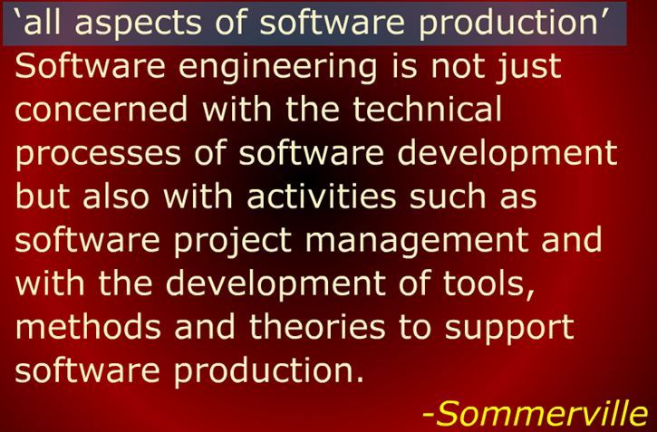
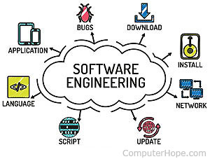
Software Engineering Definition

Slide 23
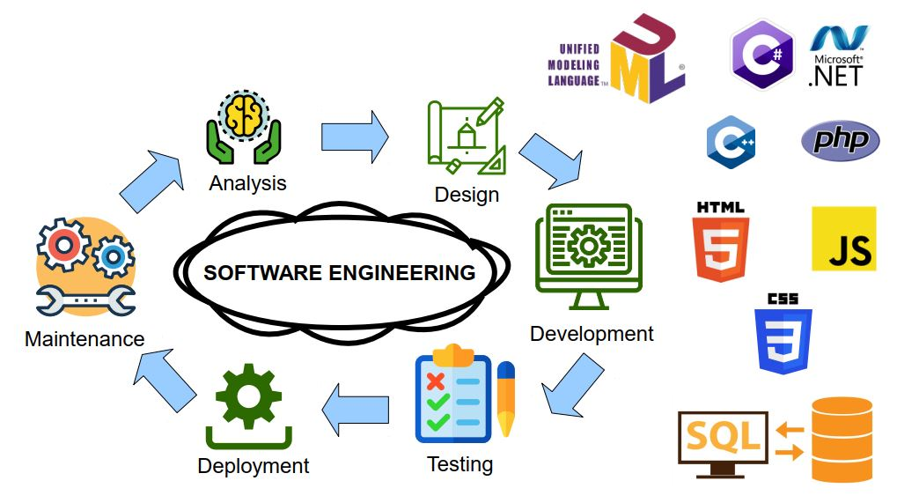

Slide 24
The Role of Software Engg. (1)
A bridge from customer needs to programming implementation
Customer
Software Engineering
Programmer
First law of software engineering
Software engineer is willing to learn the problem domain
(problem cannot be solved without understanding it first)
Notes:
"You cannot solve it, unless you understand it."

Slide 25
The Role of Software Engg. (2)

Slide 26
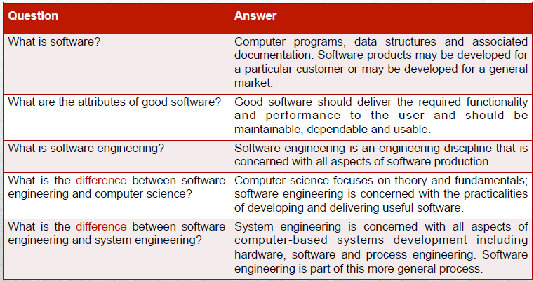

Slide 27
FAQ about software engineering
Question | Answer
What are the key challenges facing software engineering? | Coping with increasing diversity, demands for reduced delivery times and developing trustworthy software.
What are the costs of software engineering? | Roughly 60% of software costs are development costs, 40% are testing costs. For custom software, evolution costs often exceed development costs.
What are the best software engineering techniques and methods? | While all software projects have to be professionally managed and developed, different techniques are appropriate for different types of system. For example, games should always be developed using a series of prototypes whereas safety critical control systems require a complete and analyzable specification to be developed. You can’t, therefore, say that one method is better than another.
What differences has the web made to software engineering? | The web has led to the availability of software services and the possibility of developing highly distributed service-based systems. Web-based systems development has led to important advances in programming languages and software reuse.

Slide 28
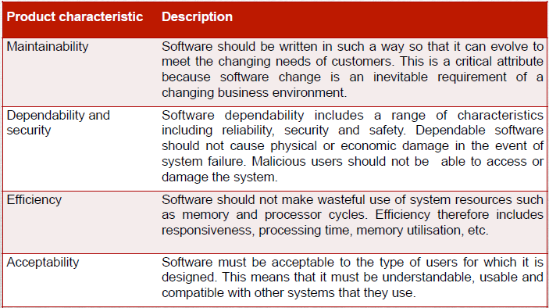
Well-engineered software Characteristics

Slide 29
SOFTWARE ENGINEERING- A Layered Technology
Any engineering approach must rest on organizational commitment to quality which fosters a continuous process improvement culture.
Process layer as the foundation defines a framework with activities for effective delivery of software engineering technology. Establish the context where products (model, data, report, and forms) are produced, milestone are established, quality is ensured and change is managed.
Method provides technical how-to’s for building software. It encompasses many tasks including communication, requirement analysis, design modeling, program construction, testing and support.
Tools provide automated or semi-automated support for the process and methods.

Slide 30
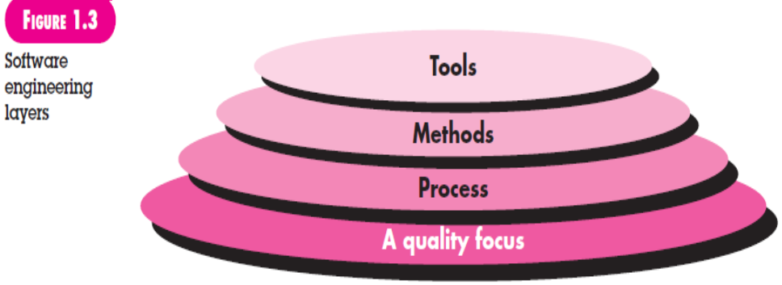
A Layered Technology

Slide 31
Software Process
A process is a collection of activities, actions and tasks that are performed when some work product is to be created. It is not a rigid prescription for how to build computer software. Rather, it is an adaptable approach that enables the people doing the work to pick and choose the appropriate set of work actions and tasks.
Purpose of process is to deliver software in a timely manner and with sufficient quality to satisfy those who have sponsored its creation and those who will use it.

Slide 32
A Process Framework
A process framework establishes the foundation for a complete software engineering process by identifying a small number of framework activities that are applicable to all software projects, regardless of their size or complexity. In addition, the
process framework encompasses a set of umbrella activities that are applicable across the entire software process.
Process framework
Framework activities
work tasks
work products
milestones & deliverables
QA checkpoints
Umbrella Activities

Slide 33
Five Activities of a Generic Process framework
Communication: communicate with customer to understand objectives and gather requirements
Planning: creates a “map” defines the work by describing the tasks, risks and resources, work products and work schedule.
Modeling: Analysis of requirements and design.
Construction: code generation and the testing.
Deployment: Delivered to the customer who evaluates the products and provides feedback based on the evaluation.
These five framework activities can be used to all software development regardless of the application domain, size of the project, complexity of the efforts etc., though the details will be different in each case.
For many software projects, these framework activities are applied iteratively as a project progresses. Each iteration produces a software increment that provides a subset of overall software features and functionality.

Slide 34
Umbrella Activities
Complement the five process framework activities and help team manage and control progress, quality, change, and risk.
Software project tracking and control: assess progress against the plan and take actions to maintain the schedule.
Risk management: assesses risks that may affect the outcome and quality.
Software quality assurance: defines and conduct activities to ensure quality.
Technical reviews: assesses work products to uncover and remove errors before going to the next activity.
Measurement: define and collects process, project, and product measures to ensure stakeholder’s needs are met.
Software configuration management: manage the effects of change throughout the software process.
Reusability management: defines criteria for work product reuse and establishes mechanism to achieve reusable components.
Work product preparation and production: create work products such as models, documents, logs, forms and lists.

Slide 35
Adapting a Process Model
The process should be agile and adaptable to problems. Process adopted for one project might be significantly different than a process adopted from another project. (to the problem, the project, the team, organizational culture). Among the differences are:
the overall flow of activities, actions, and tasks and the interdependencies among them.
the degree to which actions and tasks are defined within each framework activity
the degree to which work products are identified and required!
the manner which quality assurance activities are applied!
the manner in which project tracking and control activities are applied!
the overall degree of detail and rigor with which the process is described!
the degree to which the customer and other stakeholders are involved with the project!
the level of autonomy given to the software team!
the degree to which team organization and roles are prescribed!

Slide 36
The Essence of Practice
How does the practice of software engineering fit in the process activities mentioned above? Namely, communication, planning, modeling, construction and deployment.
George Polya outlines the essence of problem solving, suggests:
1.Understand the problem (communication and analysis).
2.Plan a solution (modeling and software design).
3.Carry out the plan (code generation).
4.Examine the result for accuracy (testing and quality assurance).

Slide 37
Understand the Problem
Who has a stake in the solution to the problem? That is, who are the stakeholders?
What are the unknowns? What data, functions, and features are required to properly solve the problem?
Can the problem be compartmentalized? Is it possible to represent smaller problems that may be easier to understand?
Can the problem be represented graphically? Can an analysis model be created?

Slide 38
Plan the Solution
Have you seen similar problems before? Are there patterns that are recognizable in a potential solution? Is there existing software that implements the data, functions, and features that are required?
Has a similar problem been solved? If so, are elements of the solution reusable?
Can subproblems be defined? If so, are solutions readily apparent for the subproblems?
Can you represent a solution in a manner that leads to effective implementation? Can a design model be created?

Slide 39
Carry Out the Plan
Does the solution conform to the plan? Is source code traceable to the design model?
Is each component part of the solution provably correct? Has the design and code been reviewed, or better, have correctness proofs been applied to algorithm?

Slide 40
Examine the Result
Is it possible to test each component part of the solution? Has a reasonable testing strategy been implemented?
Does the solution produce results that conform to the data, functions, and features that are required? Has the software been validated against all stakeholder requirements?

Slide 41
How It all Starts
Every software project is precipitated by some business need—
the need to correct a defect in an existing application;
the need to the need to adapt a ‘legacy system’ to a changing business environment;
the need to extend the functions and features of an existing application, or
the need to create a new product, service, or system.

Slide 42
Case Studies
A personal insulin pump
An embedded system in an insulin pump used by diabetics to maintain blood glucose control.
A mental health case patient management system
A system used to maintain records of people receiving care for mental health problems.
A wilderness weather station
A data collection system that collects data about weather conditions in remote areas.

Slide 43
Insulin pump control system
Collects data from a blood sugar sensor and calculates the amount of insulin required to be injected.
Calculation based on the rate of change of blood sugar levels.
Sends signals to a micro-pump to deliver the correct dose of insulin.
Safety-critical system as low blood sugars can lead to brain malfunctioning, coma and death; high-blood sugar levels have long-term consequences such as eye and kidney damage.

Slide 44
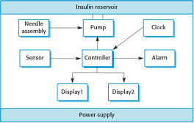
Insulin pump hardware architecture

Slide 45
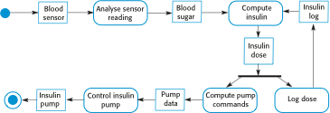
Activity model of the insulin pump

Slide 46
Essential high-level requirements
The system shall be available to deliver insulin when required.
The system shall perform reliably and deliver the correct amount of insulin to counteract the current level of blood sugar.
The system must therefore be designed and implemented to ensure that the system always meets these requirements.

Slide 47
A patient information system for mental health care
A patient information system to support mental health care is a medical information system that maintains information about patients suffering from mental health problems and the treatments that they have received.
Most mental health patients do not require dedicated hospital treatment but need to attend specialist clinics regularly where they can meet a doctor who has detailed knowledge of their problems.
To make it easier for patients to attend, these clinics are not just run in hospitals. They may also be held in local medical practices or community centers.

Slide 48
MHC-PMS
The MHC-PMS (Mental Health Care-Patient Management System) is an information system that is intended for use in clinics.
It makes use of a centralized database of patient information but has also been designed to run on a PC, so that it may be accessed and used from sites that do not have secure network connectivity.
When the local systems have secure network access, they use patient information in the database but they can download and use local copies of patient records when they are disconnected.

Slide 49
MHC-PMS goals
To generate management information that allows health service managers to assess performance against local and government targets.
To provide medical staff with timely information to support the treatment of patients.

Slide 50
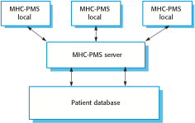
The organization of the MHC-PMS

Slide 51
MHC-PMS key features
Individual care management
Clinicians can create records for patients, edit the information in the system, view patient history, etc. The system supports data summaries so that doctors can quickly learn about the key problems and treatments that have been prescribed.
Patient monitoring
The system monitors the records of patients that are involved in treatment and issues warnings if possible problems are detected.
Administrative reporting
The system generates monthly management reports showing the number of patients treated at each clinic, the number of patients who have entered and left the care system, number of patients sectioned, the drugs prescribed and their costs, etc.

Slide 52
MHC-PMS concerns
Privacy
It is essential that patient information is confidential and is never disclosed to anyone apart from authorised medical staff and the patient themselves.
Safety
Some mental illnesses cause patients to become suicidal or a danger to other people. Wherever possible, the system should warn medical staff about potentially suicidal or dangerous patients.
The system must be available when needed otherwise safety may be compromised and it may be impossible to prescribe the correct medication to patients.

Slide 53
Wilderness weather station
The government of a country with large areas of wilderness decides to deploy several hundred weather stations in remote areas.
Weather stations collect data from a set of instruments that measure temperature and pressure, sunshine, rainfall, wind speed and wind direction.
The weather station includes a number of instruments that measure weather parameters such as the wind speed and direction, the ground and air temperatures, the barometric pressure and the rainfall over a 24-hour period. Each of these instruments is controlled by a software system that takes parameter readings periodically and manages the data collected from the instruments

Slide 54

The weather station’s environment

Slide 55
Weather information system
The weather station system
This is responsible for collecting weather data, carrying out some initial data processing and transmitting it to the data management system.
The data management and archiving system
This system collects the data from all of the wilderness weather stations, carries out data processing and analysis and archives the data.
The station maintenance system
This system can communicate by satellite with all wilderness weather stations to monitor the health of these systems and provide reports of problems.

Slide 56
Additional software functionality
Monitor the instruments, power and communication hardware and report faults to the management system.
Manage the system power, ensuring that batteries are charged whenever the environmental conditions permit but also that generators are shut down in potentially damaging weather conditions, such as high wind.
Support dynamic reconfiguration where parts of the software are replaced with new versions and where backup instruments are switched into the system in the event of system failure.

